Slide 1
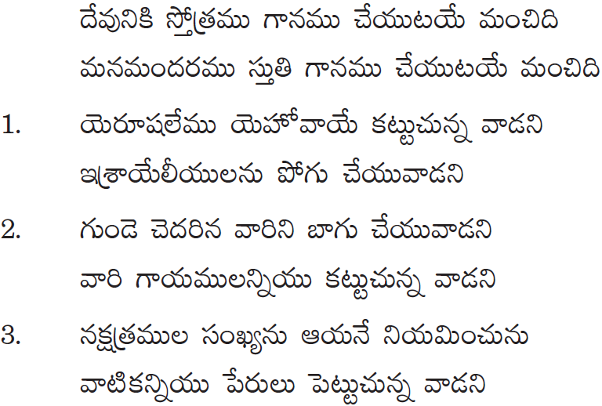
TELUGU CHRISTIAN FELLOWSHIP of MN

Slide 2
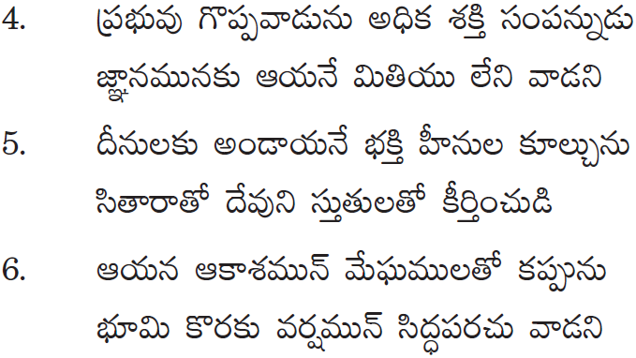
TELUGU CHRISTIAN FELLOWSHIP of MN

